Slide 1
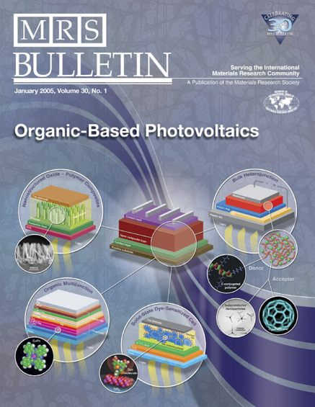
Nano-architecting of OPV’s planar heterojunction
Created by Ramon Munoz
Under the Auspices of Jayan Thomas, Ph.D
Optical Sciences, University of Arizona
NASA Space Grant Consortium Symposium
April 17th, 2010

Slide 2
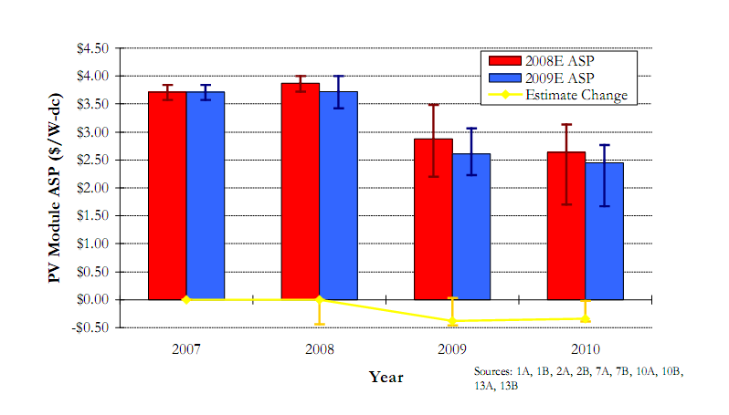
John E. Bartlett, “The Effects of the Financial Crisis on Photovoltaics: An Analysis of Changes in Market Forecasts from 2008 to 2009”, NREL, 2009.

Slide 3
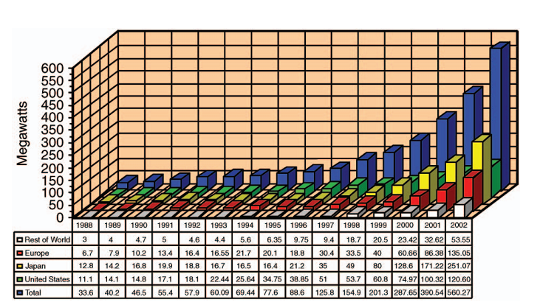
What is our reality?
P. Maycock, PV News (February 2003).
Notes:
Figure 2.World photovoltaic module production (megawatts), total consumer and commercial use, per country.

Slide 4
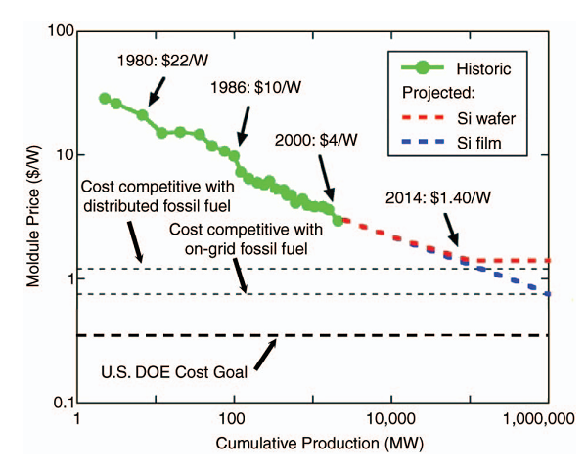
R.M. Margolis, “Photovoltaic Technology Experience Curves and Markets,” NCPV Solar Program Review Meeting, Denver, CO (2003).

Slide 5
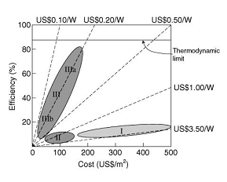
M.A. Green, “Third generation photovoltaics: concepts for high efficiency at low cost,” Proc. Electrochem. Soc. 10 (2001) p. 3.
Notes:
Figure 5.Cost-efficiency analysis for first-, second-, and third-generation photovoltaic technologies (labeled I, II, and III, respectively).Region IIIa depicts very-high-efficiency devices that require novel mechanisms of device operation. Region IIIb—the region in which organic PV devices lie—depicts devices with moderate efficiencies and very low costs.
20

Slide 6
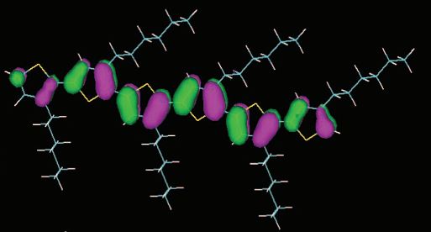
What are Organic Based Thin Film Photovoltaics?
Sean E.Shaheen, “Organic-Based Photovoltaics: Toward Low-Cost Power Generation,” MRS Bulletin, January 2005

Slide 7
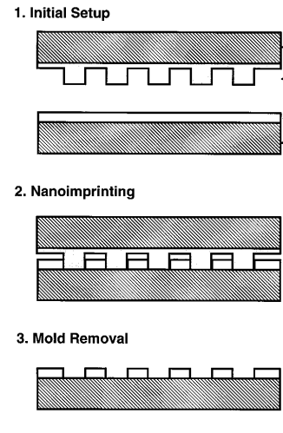
Why nano-architect the active layer?
StephenY.Chou, “Imprint of sub-25 nm vias and trenches in polymers”, UniversityofMinnesota, Minneapolis, 1995.

Slide 8
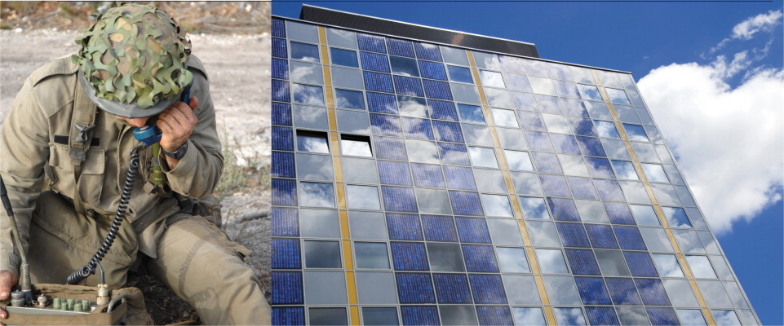
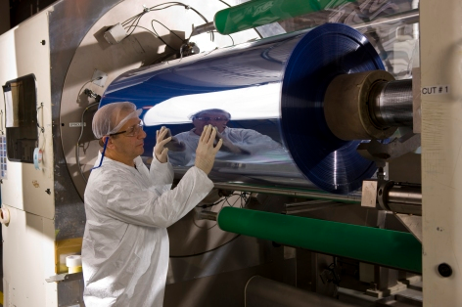
Why are they the future?
Marsh, George, “PV: make way for the organic movement,” Renewable Energy Focus, 2008.
Eideard, “Konarka starts cranking out “Power Plastic”, October, 2008. <http://eideard.wordpress.com/2008/10/08/konarka-starts-cranking-out-power-plastic/>

Slide 9
Thank you
Thank you to Dr. Jayan Thomas, NASA Space Grant Consortium, Peyghambarian Research Group, and my parents

